Slide 1




Semantic web for scientific information Streamlining how we write, find, link and reuse data and models
Ferdinando Villa & Integrated Modelling Partnership

Slide 2


An integrated solution for shared, distributed, collaborative modelling
SEMANTICS FOR DATA AND COMPUTATIONS
Maintenance of the core conceptualization and language
Maintenance and delivery of a shared worldview (ontologies) for cross-domain communication
APPLICATIONS
Ecosystem services assessment (ARIES)
Real-time monitoring using remotely sensed data
Food and other environmental securities
Integrating hydrology, primary production, nutrients with agent models of SES.
OPEN SOURCE SOFTWARE
User-end (modelers and end users)
Server technology (institutions)
Developer team and user support
COLLABORATIVE MODELING
Interoperable data and models
Serving models on the Web
Direct support of partner projects
International Spring University since 2013
INTEGRATED MODELING INFRASTRUCTURE
Assembly of models from networked data and model components
Partners can manage their servers or use the partnership’s
Notes:
Spiega IMP come unica soluzione possibile – no pitching – we can only get there together

Slide 3


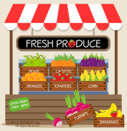
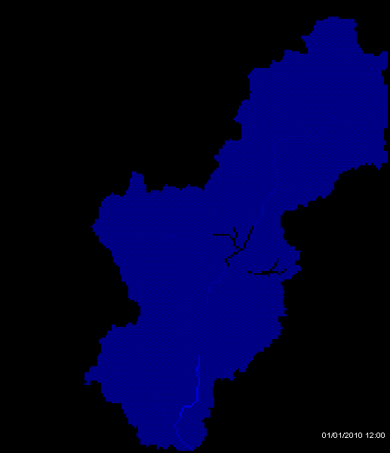
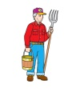
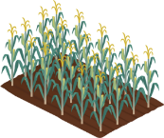
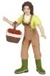
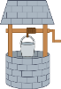
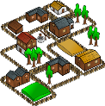
Models and data live on a semantic web An extensible network hosts data, models and model services available to users
Query:
Set context to region X
Observe water social dynamics in it
Query issued
Delineate
watershed
Results!
?
Find transactors
Compute
hydrological
model
Find beneficiaries
Build flow network
Weather model
Flow models
Compute assessment in context

Slide 4
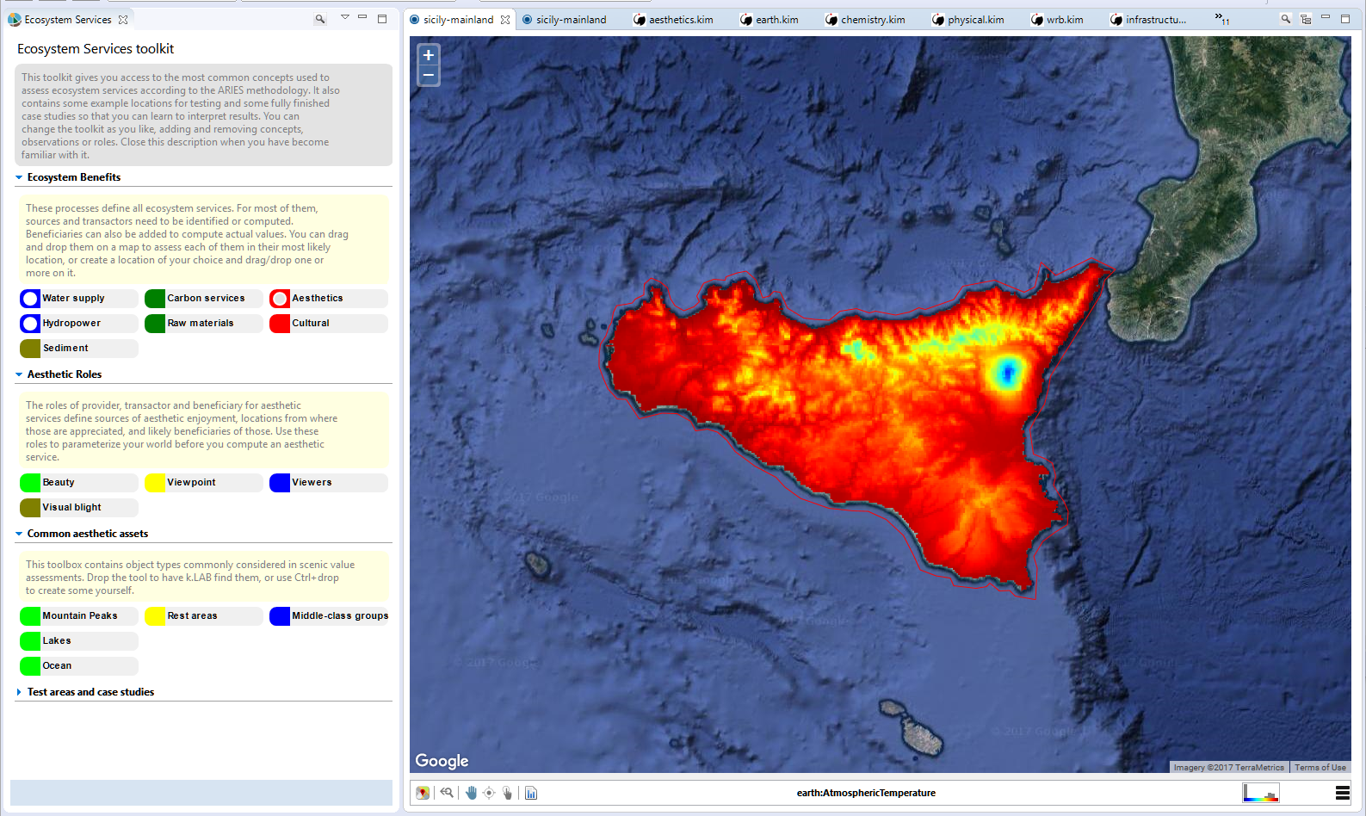
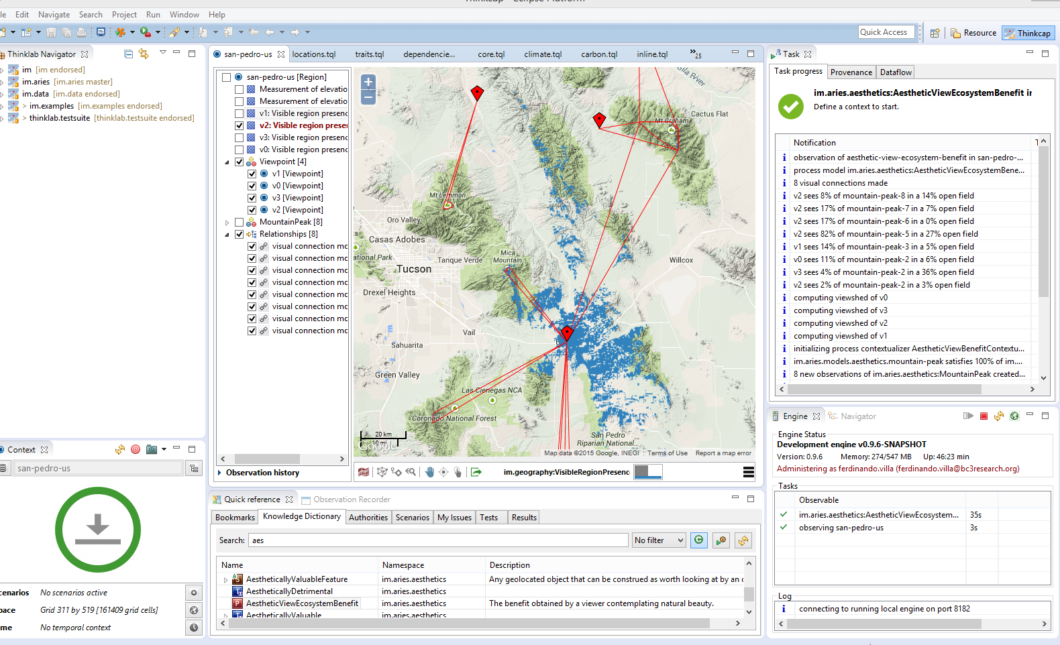
A user’s perspective: two-step assessment Client software (desktop & soon web-based) allow modeling with minimal configuration and training. Provenance info is compiled into user documentation for each result set.
…producing a complete assessment of structure and function in a context.
Drag-and-drop paradigm for end users
“Palette” of ES tools can store finished studies and scenario results
Models are built and computed when user drops the concept
Full reports are built to document the computation
…system
creates agents and processes from ontological specs
builds best-case model out of components and data on the semantic network
computes it…
Step 1:
Set overall context
(search or draw on Google map)
Step 2:
Drag/drop the concept to observe
User is logged into network
through secure certificate

Slide 5
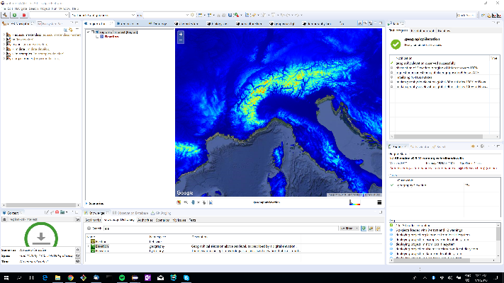
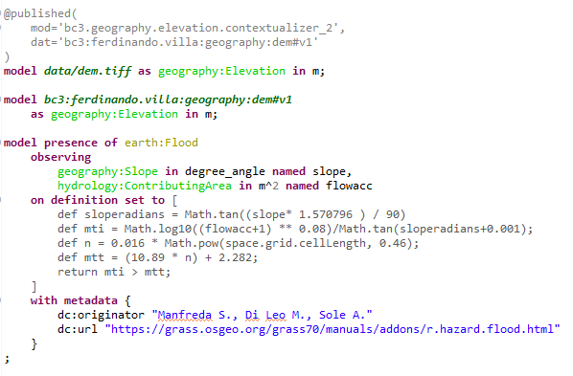


A modeler’s/data scientist’s perspective streamlining and supporting the annotation workflow for both data and computations
Raster DEM
Synchronized domain ontologies (worldview)

Slide 6
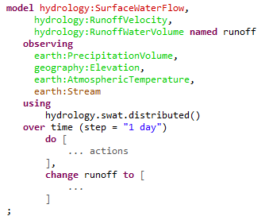
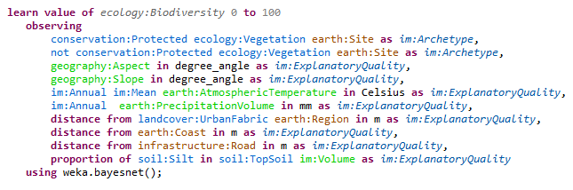
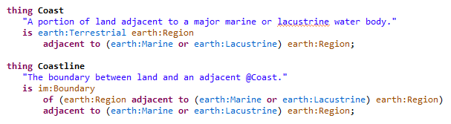
One language for knowledge, data and computations Uses English-like syntax to express the observation ontology; linguistic approach keeps ontologies small and learnable
Machine learning model
Hydrological model
Ontological statements read as English and are validated while editing. Inconsistent concepts are flagged as errors and discarded.
Color coding, assisted editing, and informative error messages help user
Often dozen of OWL axioms in 1-2 lines
from IM worldview (general users receive it from the network and search it)

Slide 7
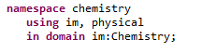
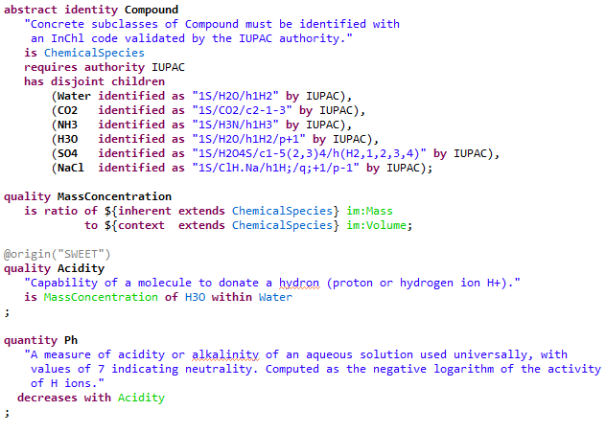
Worldviews merge domains and vocabularies reliably and intuitively
Explicit domains
Assisted editor with as-you-type syntax validation
syntax embodies observation semantic
predicate and observable composition
usage of attributes
Logical validation at each save
Uses reasoner of choice
Consistency of usages with upper ontology
(potentially nested) inherency...
Bridging to vocabularies through endorsed authorities
GBIF (taxonomic identities)
IUPAC (chemical identities)
WRB (soil identities)
AGROVOC (agri processes and practices)
... (plug-in)

Slide 8
Provenance ontology
prov:Activity
prov:Entity
Description
Observation
(inf. artifact)
Observable
Predicate
Acknowledgement
Structural description (graph, ...)
Subject
Attribute
Computation
Agent
Realm
Dynamic description (DDEs, dataflow...)
Event
Identity
Instantiation
Process
Ordering
Resolution
Collection (objects: database, vector...)
Quality
Role
State (map, timeseries...)
Physical property
Observation ontology
Emergence
Numerosity
Value
Type
Extent
Relationship
Functional
Structural
Upper Ontology
(BFO & DOLCE tested)
Root domain
(connect observables and predicates to UO)
Scale
(granularity, space/time topology)
Physical domains
(earth, materials,...)
Knowledge domains
(disciplinary: geography, chemistry, economics...)
Worldview
urn:klab:node:user:namespace:id
Data geometry becomes scale through the worldview
Roles reinterpret physical
“reality” according to disciplines

Slide 9
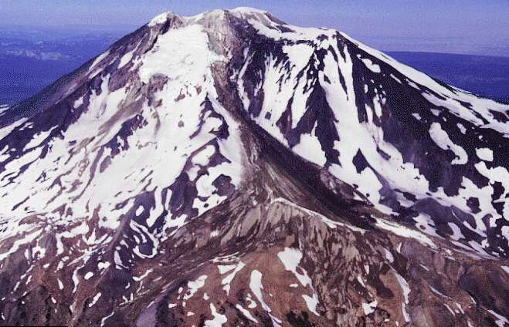
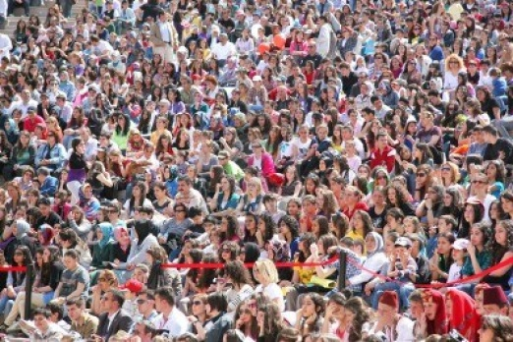
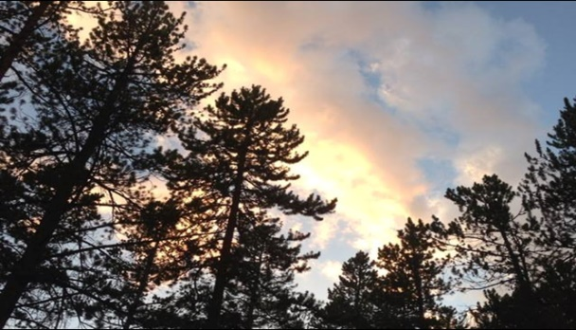
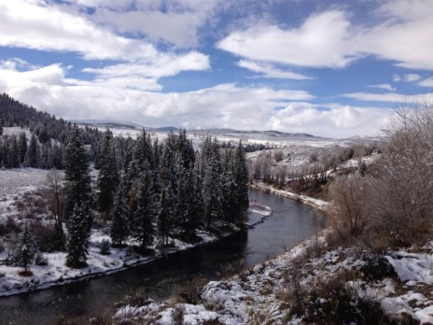
A semantics-first approach - for wide user groups
Address all the “W’s of information – what, where, when, why, and how – without becoming too large or complex to learn and use.
SUBJECTS:
A mountain A group of humans A forest A river
QUALITIES:
Elevation (measurement) Per capita income (value) Percent tree canopy cover (%) Stream order (ranking)
PROCESSES:
Erosion Migration Tree growth Streamflow
EVENTS:
Snowfall A birth Death of a tree A flood event
RELATIONSHIPS: ↖ Skiers using a mountain for recreation ↗ ↖ A city using a river for water supply ↗
Semantics for predicates allow to compose attributes, realms and identities without inheritance; interface to vocabularies
Roles account for usages of general observables in disciplinary contexts without giving up consistency and FAIR goals

Slide 10
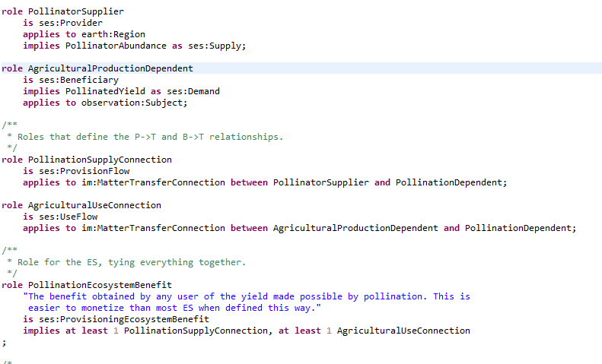
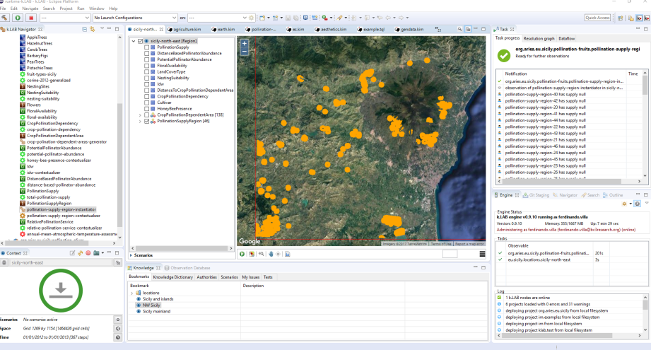
Tooling (1): k.IM language and support software
Tools and interfaces enable end users, modelers, and network administrators
Simplify the tasks of semantically describing, coding, and publishing data and models.
Provide and maintain documentation, community resources for discussion, user support and bug reporting
Create tools for participatory, graphical model building that can be directly translated into templates for working models.
The k.IM language is used to express both the worldview and the data/models that use it

Slide 11
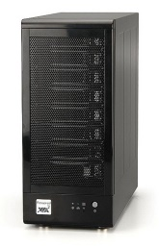
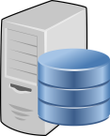
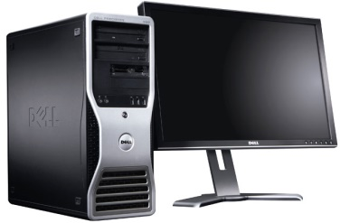
Tooling (2): distributed semantic web infrastructure
Web users connect to modeling engine and use web interface for modeling
UI is drag-and-drop only, optimized for non-technical user
Each server provides * knowledge (worldview) * semantic data and models * software components * user authentication
Network of semantic servers (k.Server software) sharing worldview
Modelers have a private engine and connect to the network using the modeling IDE
UI is optimized for developers and modelers
Modeling engines
resolve user queries into working models
find content on the semantic network

Slide 12
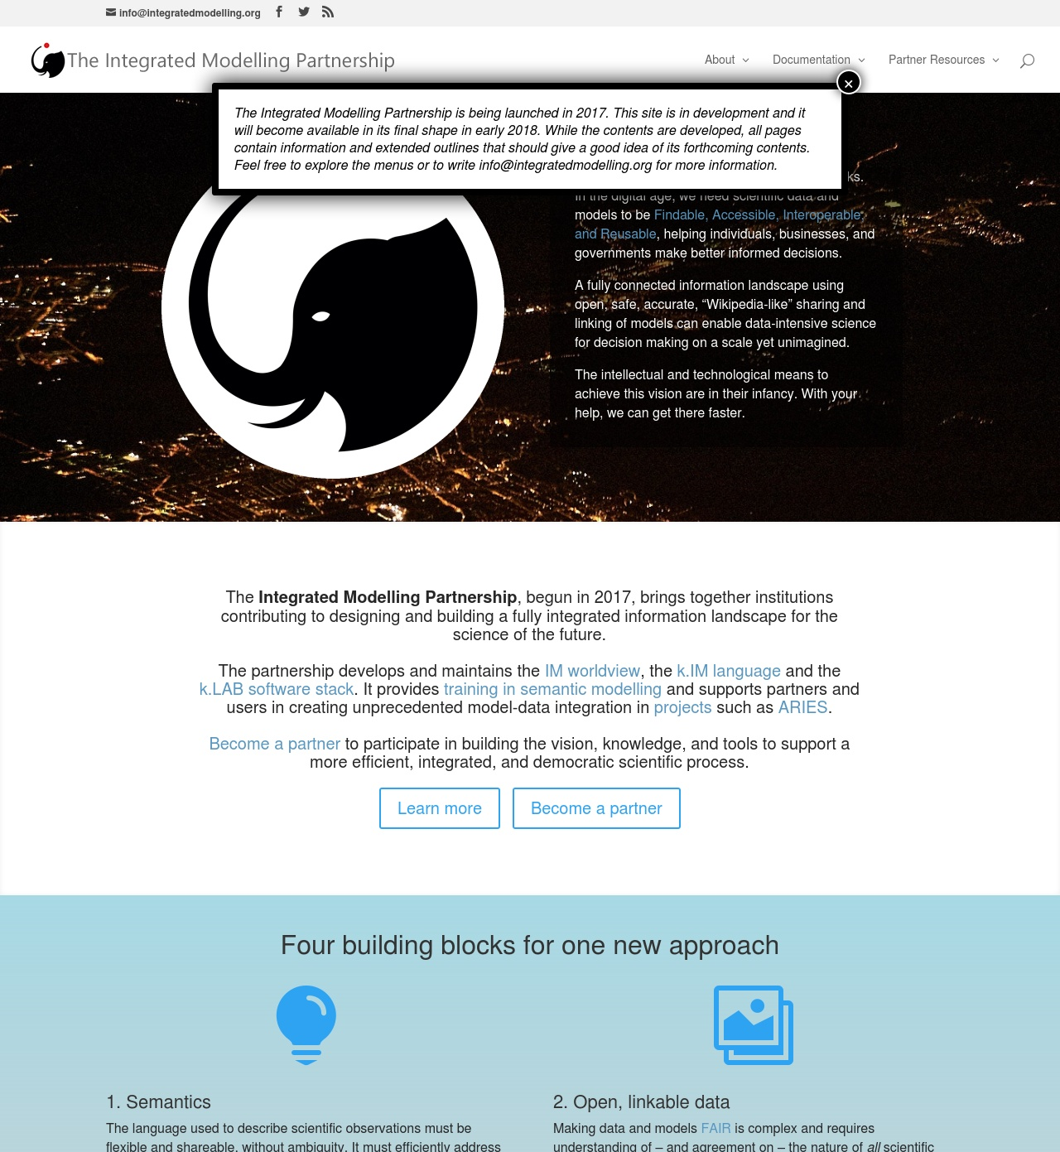
The Integrated Modelling Partnership http://www.integratedmodelling.org
Partners share:
Participation
design their applications in collaboration with the core staff
Work Packages drive the development of larger initiatives
Ownership
all the products (worldview, software, online courses) are open source/open access
Products bear the copyright of the partnership with its member institutions.
Control:
partners enter the steering committee that defines activities, governance and directions of development
Maintains:
Downloadable software and documentation for users and developers.
Certification for users and institutions
The shared worldview for all domains, prioritizing needs of partners.
Online data and models annotated with worldview semantics and identified by unique
Supports partners in deploying their own servers and modeling engines.
Online courses and training material on integrated modelling.
Public issue tracking, knowledge base and developer online support channels.

Slide 13
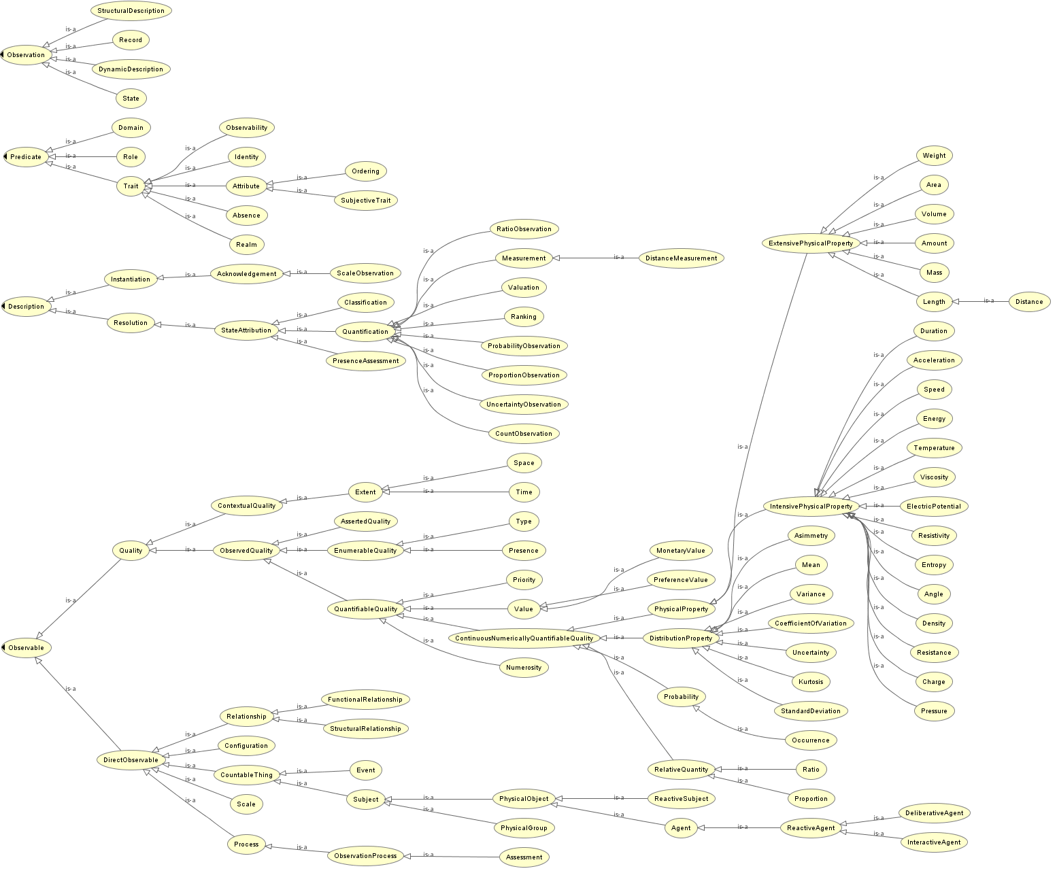

Slide 14
Promoting semantics-first solutions for open, linkable data and models
In today's dialogue on interoperability, information equals data. Both data and models can be seen as ways to make scientific observations – definitions of observations. Doing so enables a consistent discussion on how to semantically connect data to models and how to build complex models by assembling simpler ones.
Semantics-first data/models are first-class research objects that can be found online, read and understood by computers and humans alike. They can reuse existing vocabularies and thesaura while ensuring consistent semantics throughout the information landscape.
Powered by semantics, artificial intelligence can transparently match data and models to a chosen time, place, problem, and (multiple!) scales.
Much of the complexity of building and running models can be handled by machines, with substantial advantages for science and decision making.

Slide 15
The challenge of data/model integration and reuse
Scientists in the past collected data in notebooks. In the digital age, we want scientific data and models to be FAIR - Findable, Accessible, Interoperable, and Reusable, to ensure their maximum value.
A fully connected information landscape using open, safe, accurate, “Wikipedia-like” sharing and linking of models can enable data-intensive science for decision making on a scale yet unimagined:
reuse the abundance of data and specialized knowledge available and needed to analyse social and natural processes (and their interactions)
avoid the risk of fragmentation hidden in the use of ad-hoc (or no) semantics to describe data
enable simple user workflows in modelling, supporting direct questions like: What is the social dynamics of water in basin X? How does switching to crop Y affect rural food security in region Z?
Where are we along this path in 2017?

Slide 16
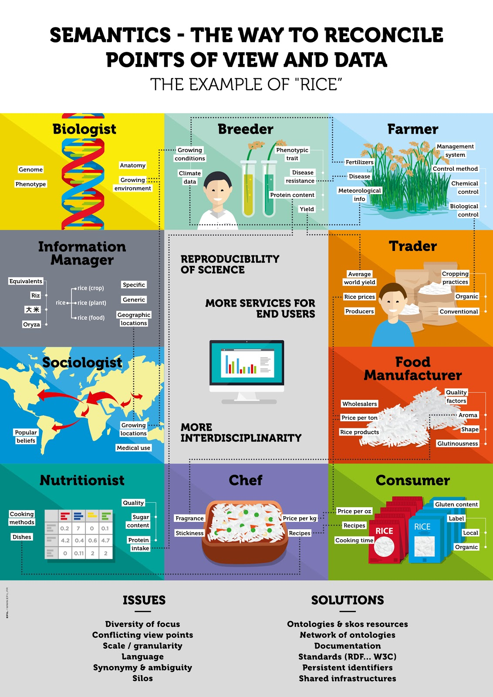
Using and reusing data: The state of the art
Distributed access to datasets over the web (OGC, OpenDAP, …)
Linked Open Data paradigm: open standards, each artifact is coupled with a URI pointing to its “meaning”.
Problem: the meaning differs for each observer - unless semantics is coherent across domains, uses and goals.
If it’s not consistent, it’s not FAIR
Image credits: INRA, AgriSemantics RDA working group

Slide 17
Reusing models
Modeling paradigms represent different “metaphors” adopted during model design:
process-based vs. agent-based
stochastic/probabilistic vs.deterministic models
spatial vs. non-spatial, raster/vector, continuous vs. discrete time, etc.
It remains difficult to mix and match models incarnating different paradigms across the lifecycle of an application.
Often, complex problems are handled with one paradigm that fits some components but must be “tricked” to handle the rest.
As a result models are still brittle monoliths, hard to disassemble and reassemble.
Integrating architectures (OpenMI &C.) only handle the technical aspects of integration, addressing only a subset of the problem.

Slide 18
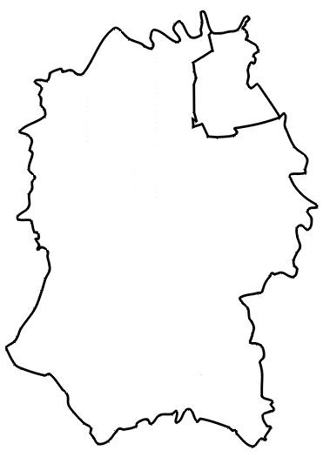
A case in point: accounting for human-natural interactions
We know the limitations of “proxy” models – and it’s not because of decision makers.
Still, building models of the true system models is hard - impossible in rapid assessments
P
B
“proxy”
T
P
B
compute
T
P
B
@ time = t

Slide 19
Adaptive, assisted system characterization Driven by semantics and by roles, supporting a specific view of physical phenomena without introducing ambiguities
A FULL DYNAMIC ACCOUNT OF NATURAL VALUE
P 1
POTENTIAL VALUE
ACCRUED VALUE
B1
T1
P2
B2
provision
use
T2
P3
B3
Providers (e.g. forests, watersheds): where valuable ecosystem function happens
Transactors (e.g. wells, crops, atmosphere): where natural value is generated
Beneficiaries (e.g. farmers, coastal dwellers): demand agents for natural value

Slide 20

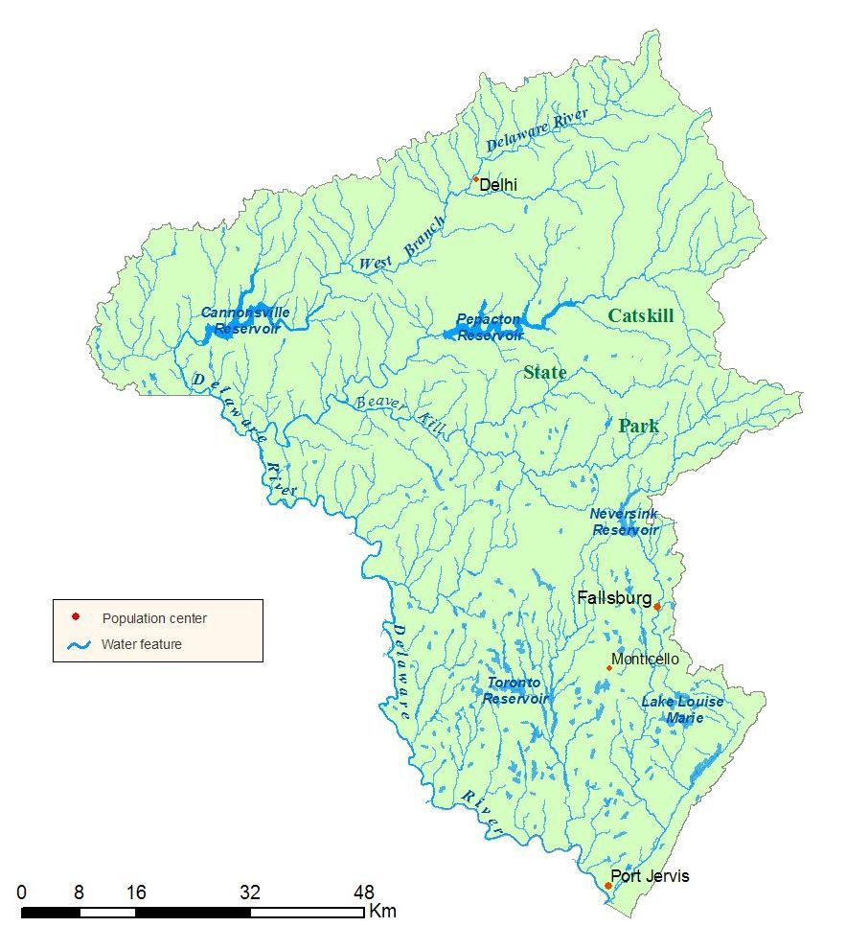

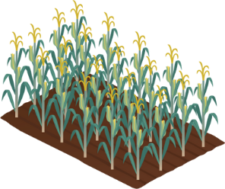

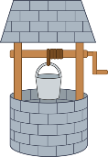
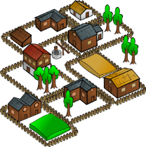
Example: building an eco-social flow network Triggered by a simple query: “observe social dynamics of water in watershed X”
Providers (e.g. forests, watersheds) are first identified and built by the AI engine.
The ontologies define types of Transactors (e.g. wells, crops, atmosphere), identified last.
Beneficiaries (e.g. farmers, coastal dwellers) are identified next.
The model for the system then creates and classifies all relationships, starting with provision (provider->transactor)…
…and following with use (beneficiary <- transactor), building a (potentially) differently scaled model for each flow.
Intermediate transactors (e.g. markets) are brought in according to the ontologies. They can be local or remote.

Slide 21
Resolution of models based on semantics
Model statements are stored in a distributed database. Each dependency is stated conceptually and resolved contextually.
CarbonSequestration 1
Observed data of CarbonSequestration in the Arctic
VegetationType 1
works globally with
Precipitation
PopulationDensity
SoilType
….
ClimateProcess 1
works only in cultivated areas
Predicts
AirTemperature
Precipitation
GrowingSeason
….
CarbonSequestration 2
works by observing
SoilDepth
VegetationType
SoilType
….
VegetationType 2
works in Europe with
Precipitation
CropMarketValue
….
AirTemperature 2
Observed global Temperature records in 2008
CarbonSequestration 3
works in the USA observing
Precipitation
DeforestationRate
….
VegetationType 3
Observed VegetationTYpe data for Africa
Precipitation 3
Observed Precipitation data in USA 2002
CarbonSequestration
VegetationType
Climate

